Slide 1
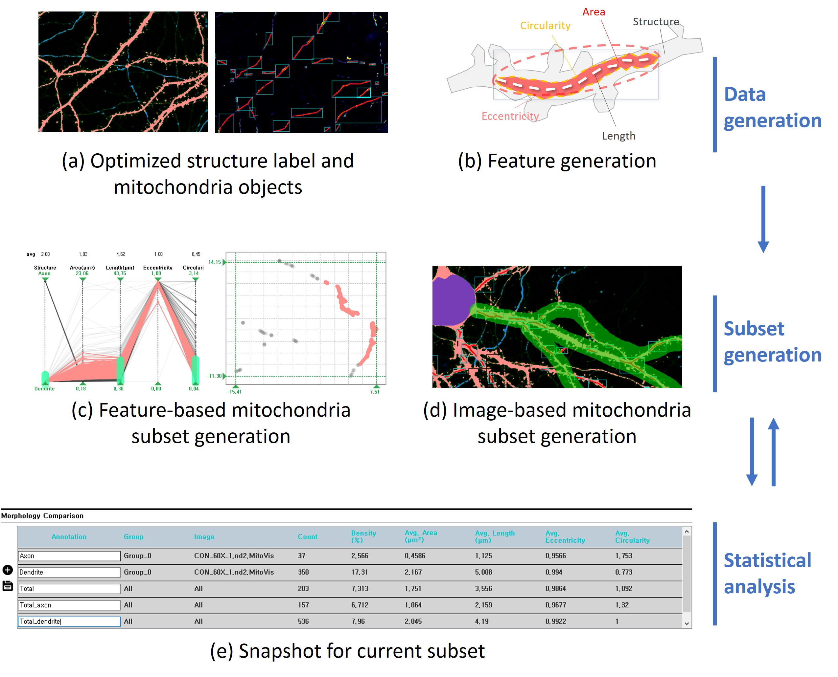
Overview
Morphology analysis through the neuron structure and mitochondria object obtained in the previous step
Generation of mitochondria subset through filtering of each plot and image-based subset generation
Save and compare statistical values of morphological features through the Snapshot function

Slide 2
Morphological feature
Structure | Area | Length | Eccentricity | Circularity
The structure of neurons where mitochondria are located (Structure segmentation through deep learning 2: dendrite 3: axon) | Mitochondrial area (Sumation of number of pixels) | Mitochondrial length (The length tracked along the center in the longest direction of the mitochondria) | Mitochondrial eccentricity (The smaller it is, the closer it is to the circle, and the larger it is, the longer it is) | Mitochondrial circularity (The closer to 0, the more distortion occurs)

